Slide 1

Stock Price Prediction Using LSTM

Slide 2

Introduction
Problem Statement
Why predict stock prices? Stock prices are highly volatile, and automating the accurate predictions can provide a competitive edge in financial markets.
Importance in Finance and Decision-Making
Assists investors in making informed decisions.
Enables better portfolio management and risk assessment.
Objective
Develop a predictive model using Long Short-Term Memory (LSTM) to accurately forecast stock prices based on historical data.

Slide 3

Libraries and Tools Used
Key Libraries
yfinance: For stock data retrieval.
NumPy/Pandas: For data manipulation and preprocessing.
TensorFlow/Keras: For building and training the LSTM model.
Plotly: For interactive data visualization.
Platform
The project was developed and executed in Jupyter Notebook.

Slide 4

Dataset Overview
Source
Data retrieved from Yahoo Finance.
Details
Data Collected For: Top 10 companies in the stock market.
Time Period Covered: Maximum historical data available.
Companies Analyzed:
Apple (AAPL)
Meta (META)
Google (GOOGL)
Microsoft (MSFT)
Tesla (TSLA)
Amazon (AMZN)
Netflix (NFLX)
NVIDIA (NVDA)
Intel (INTC)
IBM

Slide 5
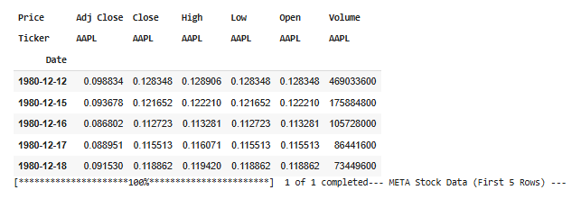
Data Fetching and Preparation
Steps Involved
Fetching Stock Data: Retrieved using the yfinance library.
Handling Missing Values: Checked for missing data, since there was no discrepancy in data, this step was skipped.
Here’s a sample of Apple (AAPL) stock data (first 5 rows of the dataset):

Slide 6
Dataset Description
Column Name | Explanation
Price | General stock price at the end of the trading day, often similar to "Close" or "Adj Close."
Adj Close | Adjusted closing price accounting for stock splits and dividends. Reflects true long-term value.
Close | The final price at which the stock was traded on a specific day.
High | Highest price reached during the trading day.
Low | Lowest price reached during the trading day.
Open | Stock price at the start of the trading session.
Volume | Total number of shares traded in a day, showing market activity.
Ticker | Symbol identifying the company (e.g., "NFLX" for Netflix).
Date | Trading date for each observation in the dataset.

Slide 7

Understanding LSTM
Overview of LSTM
A type of Recurrent Neural Network (RNN) designed to learn long-term dependencies in sequential data.
It uses memory cells to store and recall past data patterns.
Why LSTM for Stock Prediction?
Efficiently processes sequential and time-series data, which is crucial for stock price trends.

Slide 8
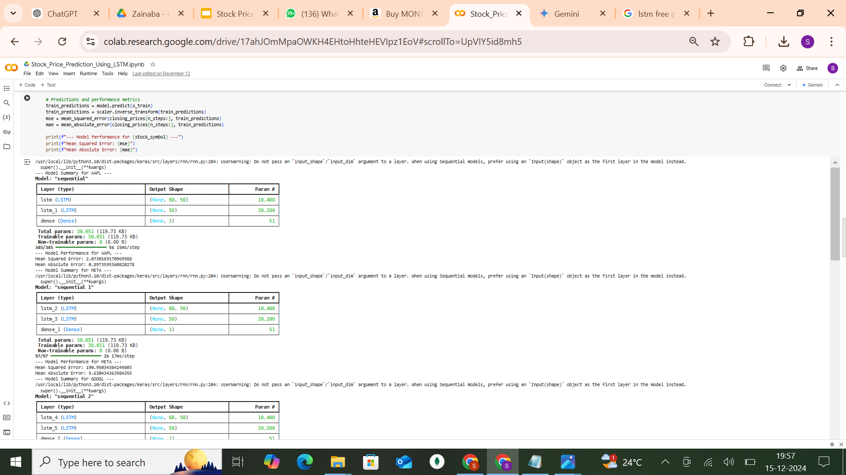
Model Architecture
Layers in the Model
LSTM Layers: Two layers with 50 units each to capture sequential patterns.
Dense Layer: Fully connected output layer with 1 unit for stock price prediction.
Loss Function: Mean Squared Error (MSE) minimizes prediction errors.
Optimizer: Adam optimizer ensures efficient training.
10 Models for Each Company
Separate LSTM models were trained for each company (e.g., AAPL, META, GOOGL), Tailored to each stock's unique historical patterns for improved accuracy.
Example model summary for apple company:

Slide 9
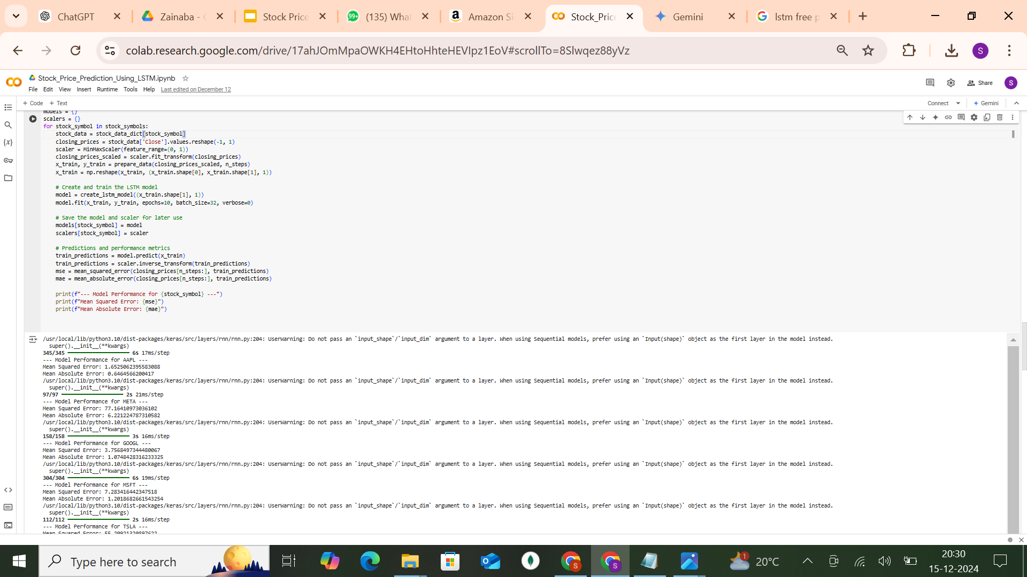
Training the Model
Process
Sequence Creation: Created input sequences of 60 time steps (past prices).
Feature and Target Splitting: Split data into X (features) and Y (target).
Model Training: Trained for 10 epochs with a batch size of 32.
Metrics Used
Mean Squared Error (MSE): Measures the average squared difference between actual and predicted prices.
Mean Absolute Error (MAE): Captures the average magnitude of prediction errors.
Example MSE and MAE (Model Performance) for Apple company model:

Slide 10
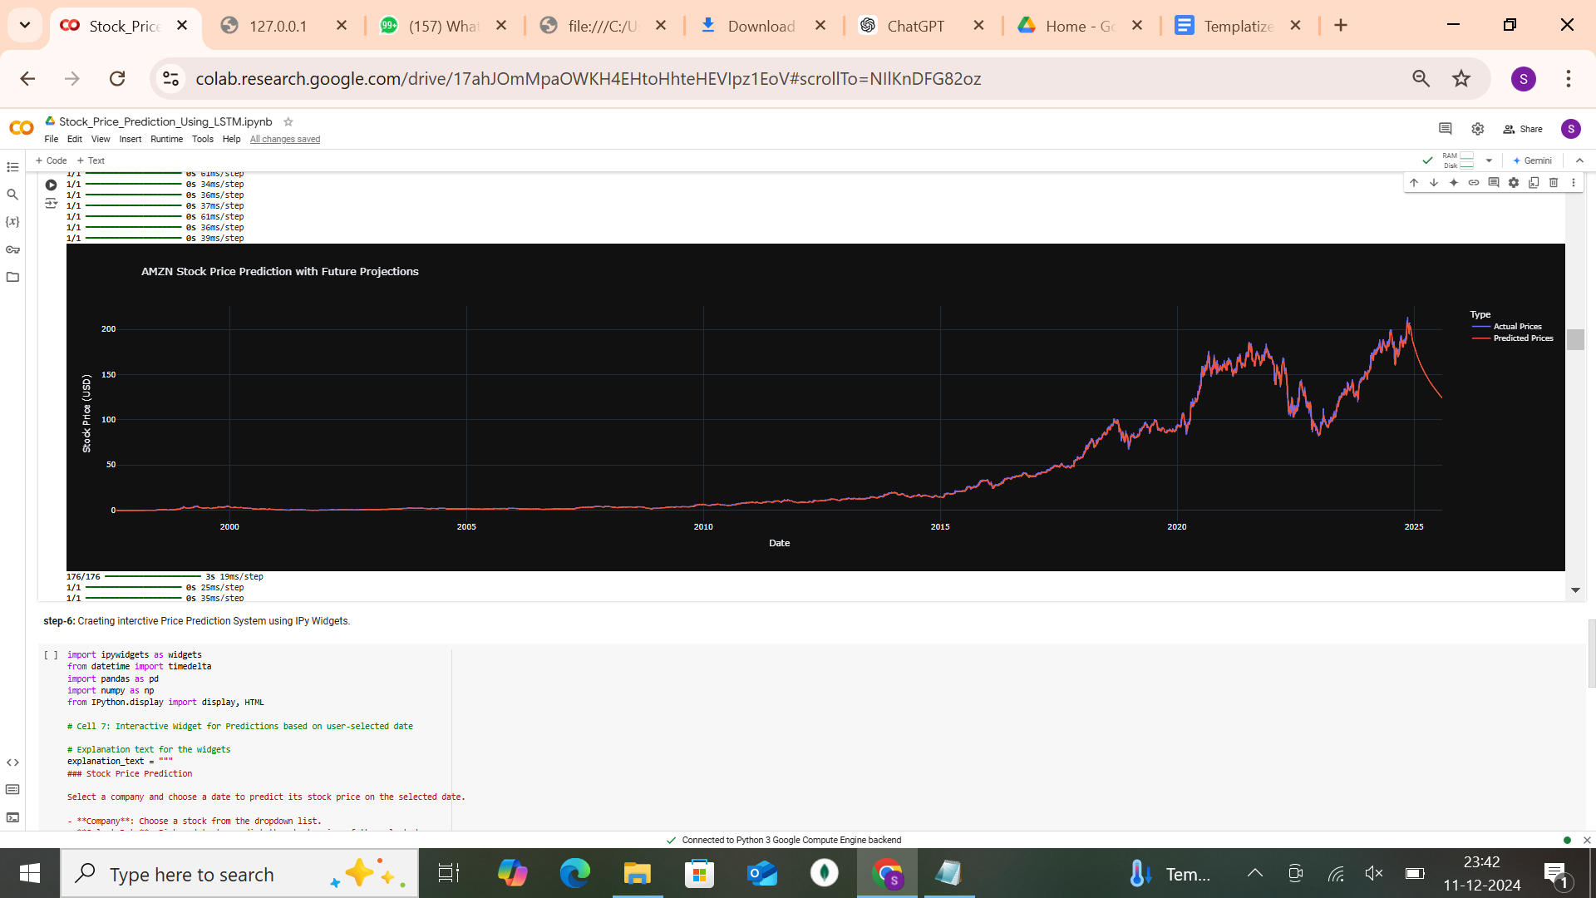
Predictions
Training Predictions
Compared actual vs. predicted prices on training data to evaluate model accuracy.
Future Predictions
Forecasted stock prices for the next 6 months using the trained model.
Interactive Plotly Graph for a sample company (e.g., Amazon)

Slide 11
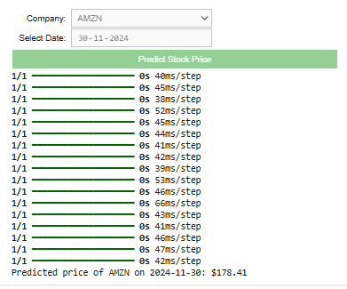
Interactive Prediction System
Widgets Implemented
Dropdown Menu: Select a company.
Date Picker: Choose a future date for prediction.
User Workflow
Allows users to interactively predict stock prices based on company and date selection.
IPyWidgets interface in Jupyter Notebook:

Slide 12
Challenges
High Volatility in Stock Prices
Stock prices are inherently volatile, often influenced by unpredictable factors such as market sentiment, geopolitical events, or sudden company-specific news.
This unpredictability can lead to inconsistencies in model performance.
Need for Extensive Hyperparameter Tuning
Optimizing parameters such as the number of LSTM units, learning rate, batch size, and sequence length requires trial-and-error and computational resources.
Poorly tuned parameters can lead to overfitting or underfitting.
Time-Intensive Training
LSTM models are computationally expensive, and training models for multiple companies requires significant time and processing power.
Data Quality and Missing Values
Missing or inaccurate stock data can impact the model’s ability to learn patterns effectively, requiring preprocessing and imputation techniques.
Risk of Overfitting
LSTMs, with their high capacity for learning patterns, can overfit on historical data if not carefully regularized or validated.

Slide 13
Limitations
Reliance on Historical Data: The model assumes that future trends are a continuation of past patterns, which is not always true in highly dynamic markets.
Exclusion of External Market Factors: External influences like news, economic policies, or global crises, which significantly impact stock prices, are not incorporated.
Limited Generalization Across Companies: A model trained on one company cannot be generalized effectively to predict prices for another company without retraining.
No Real-Time Updates: The model predictions are based on static historical data and do not adapt dynamically to new, incoming data.
Short-Term Predictions Only: The LSTM model performs better for short-term predictions but may lose accuracy for longer-term forecasts.
Market Anomalies and Unforeseen Events: Sudden market anomalies, such as stock splits, regulatory changes, or scandals, are not anticipated by the model.

Slide 14
Future Scope - Improvements
Incorporate Additional Features
Use data beyond closing prices, such as trading volume, opening prices, and high/low prices, to enhance model understanding.
Integrate market sentiment analysis by analyzing news articles, tweets, or financial reports.
Utilize Real-Time Data
Incorporate real-time data streams for dynamic model updates, enabling more accurate and up-to-date predictions.
Feature Engineering and Selection
Explore technical indicators like moving averages, RSI, and MACD, which are widely used in trading strategies.
Perform feature selection to identify the most impactful variables for stock price prediction.
Implement Transfer Learning
Develop a base LSTM model and fine-tune it for different stocks, reducing the training time and improving efficiency.
Address Market Anomalies
Introduce mechanisms to account for events like stock splits, earnings announcements, or regulatory changes that influence stock prices.

Slide 15
Future Scope - Applications
Portfolio Management
Assist investors and fund managers in selecting stocks that align with their investment goals, optimizing returns while minimizing risks.
Risk Assessment
Use predictions to anticipate market risks and help businesses or individuals mitigate potential losses during volatile periods.
Algorithmic Trading
Implement the model in automated trading systems to execute buy/sell orders based on predicted price movements.
Corporate Decision-Making
Help businesses predict their stock performance and prepare for capital-raising activities like IPOs or share buybacks.
Market Research
Offer analysts and researchers a data-driven approach to studying market trends and evaluating the performance of specific sectors or industries.

Slide 16
Conclusion
Developed a Robust Predictive Model
Successfully built and trained a Long Short-Term Memory (LSTM) neural network to predict stock prices based on historical data.
Performance Highlights
The model demonstrated high accuracy and reliability in learning patterns and forecasting prices across 10 major companies (e.g., AAPL, MSFT, GOOGL).
Key Contributions
Leveraged advanced machine learning techniques to address the challenges of sequential data prediction.
Provided insights into stock market trends and offered a basis for further exploration in financial modeling.

Slide 17


